Slide 1


Your Right To vote:
and Why it Counts!
Presented by Shirley Walker-McKinnis – Voting Rights Coordinator, and Greta K. Martin – Litigation Director and Civil Rights Attorney Both on staff at Disability Rights Mississippi On June 13, 2019 for the MS disAbility Megaconference

Slide 2

DISABILITY RIGHTS MISSISSIPPI (DRMS) is a private, non-profit corporation established to protect and advocate for the rights of individuals with disabilities.
DRMS is independent of any agency, organization, or governmental unit providing treatment, services or habilitation to individuals with disabilities.

Slide 3

The mission of DRMS is to promote, protect and advocate for the legal and human rights of all persons with disabilities and to assist them with full inclusion in home, community, education and employment.

Slide 4

Overview of P&A Programs in MS
1978 Developmental Disabilities (PADD)
1986 Mental Illness (PAIMI)
1993 All other disabilities (PAIR – individual rights)
1998 Assistive Technology Issues (PAAT)
2001 Social Security Return to Work (PABSS)
2003 Traumatic Brain Injury (PATBI)
2003 Voting Access (PAVA)
2009 SS Rep Payee (Contract)
Based on type of disability
Based on issue

Slide 5
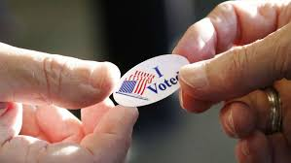
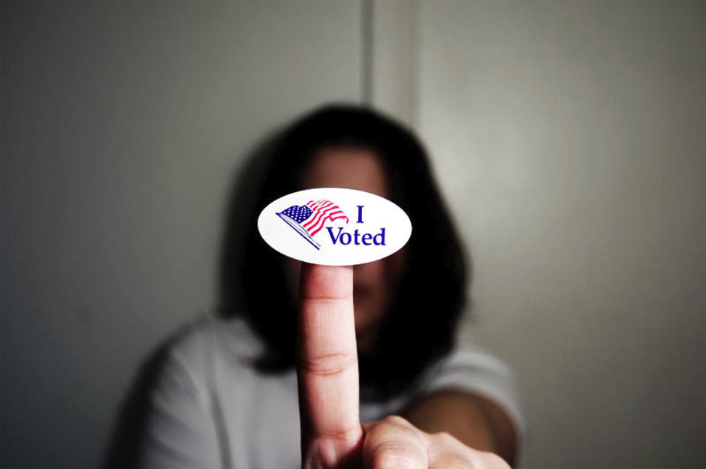
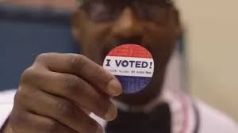

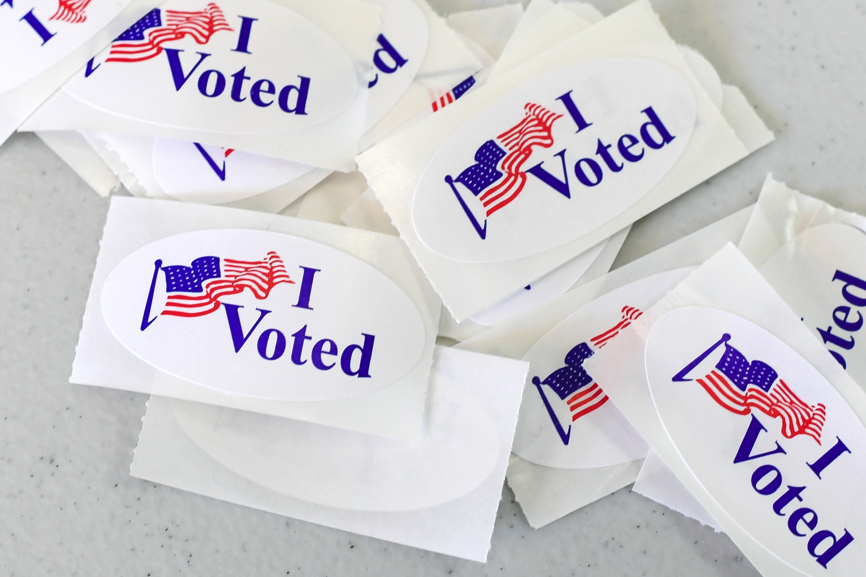
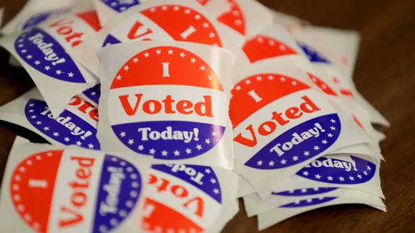
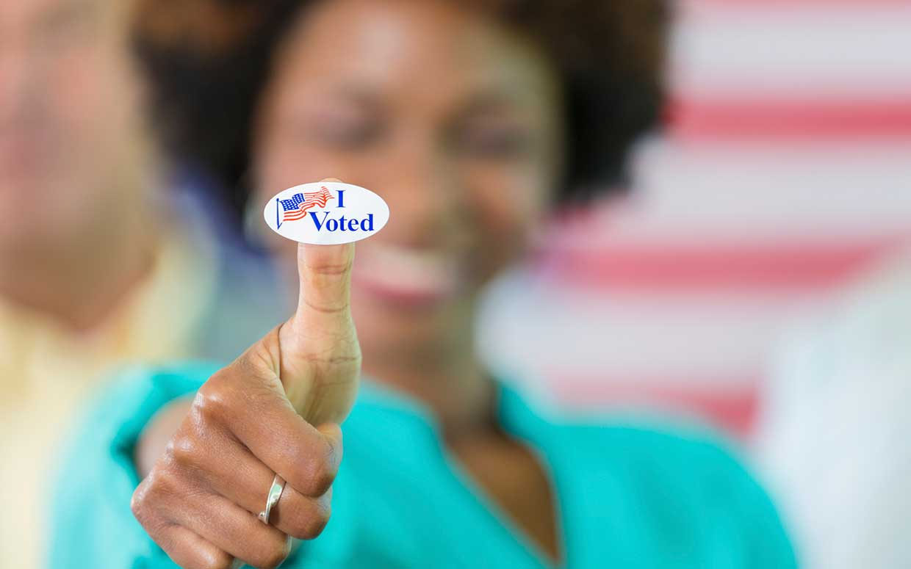
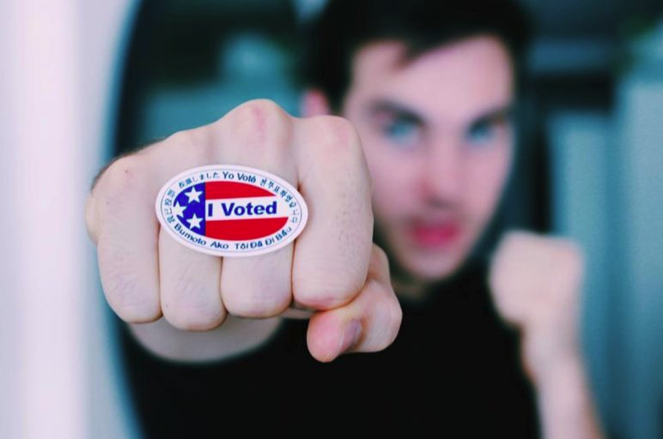
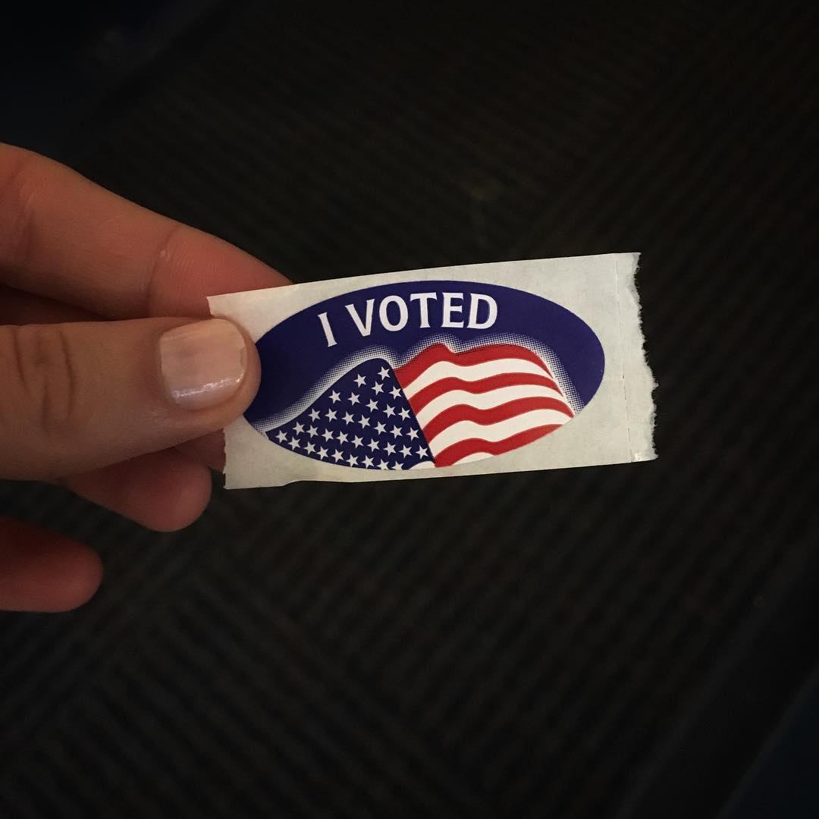

Slide 6

Voting Grant at DRMS (PAVA)
The Protection and Advocacy for Voting Access (PAVA) program was created by the Help America Vote Act (HAVA) of 2002.

Slide 7
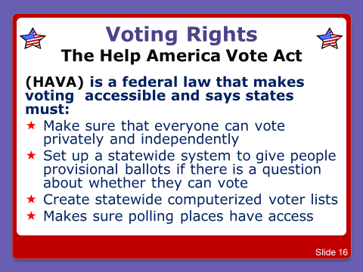


Slide 8
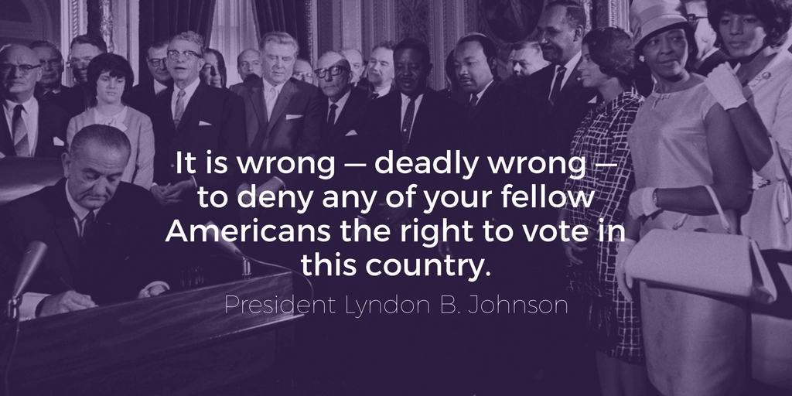
The Voting Rights Act of 1965

Slide 9
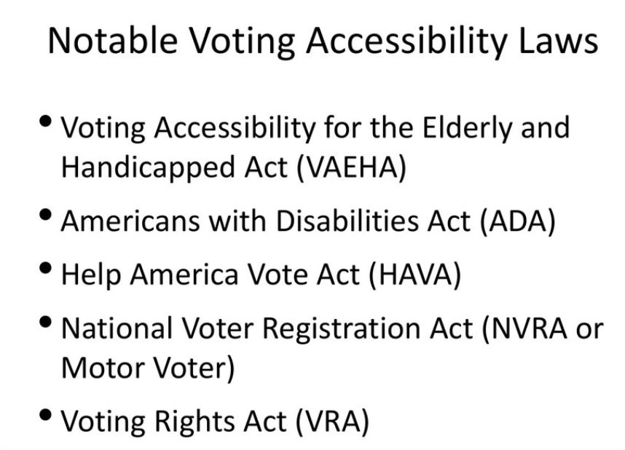
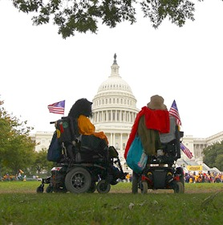

Slide 10

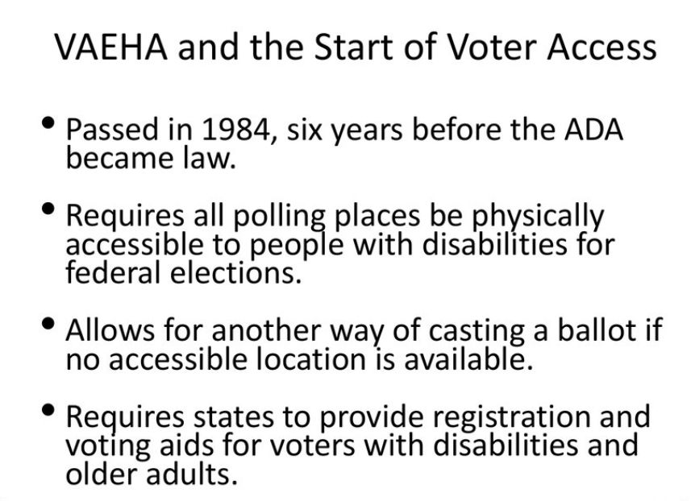

Slide 11
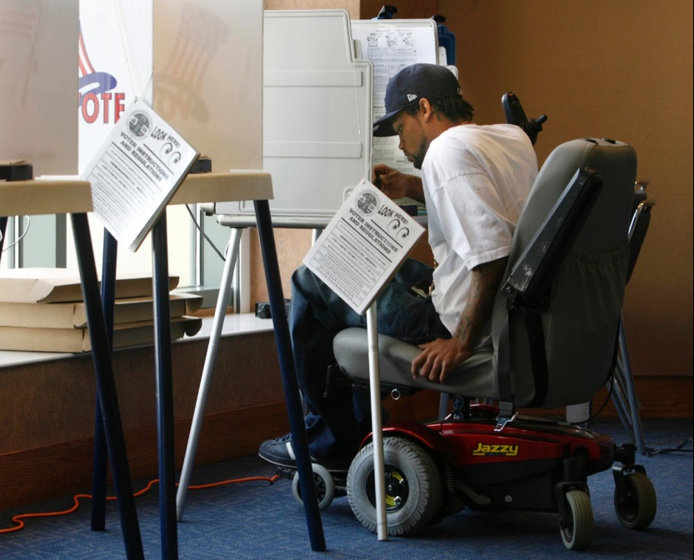
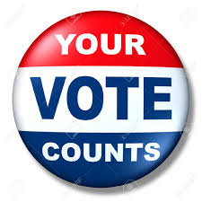
Protection & Advocacy under the Help America Vote Act
DRMS advocates:
* Provide voting rights training *Conduct polling site surveys *Host a hot-line on election days *Provide information to election officials *Participate with other P & A’s to create innovative ideas to fight rights violations

Slide 12
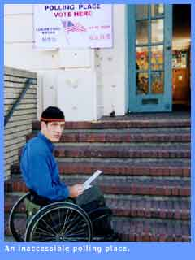
Even though we have these laws, mandates, and amendments,,,
Barriers to equal rights at the ballot still exist for people with disabilities!

Slide 13
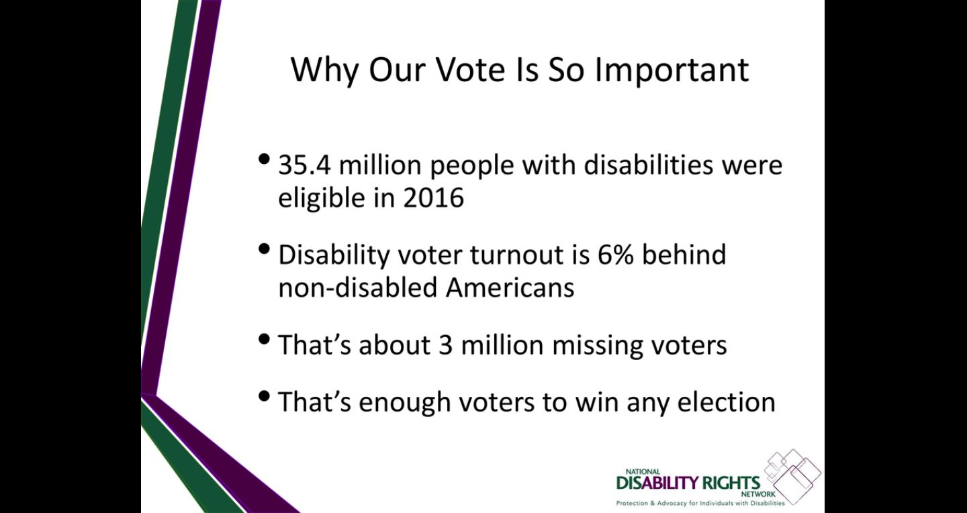

Slide 14

Notes:
So,, Why does a persons right to vote matter to the work of DRMS? How does the right to vote fit in with the purpose and goals of DRMS?

Slide 15


Community!
You may ask – What does Voting have to do with Disability Rights? Short answer: EVERYTHING!
Long Answer: It’s ultimately about the kind of communities we want in MS for the people we serve, as well as ourselves!

Slide 16
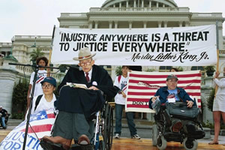
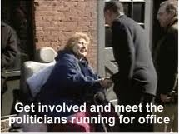
For DRMS – voting rights isn’t just another program. It’s something we integrate into the activities we already do as part of our mission and commitment to healthier communities and a better society.
Informing and encouraging voters with disabilities to take part in their civic life is a first step in helping them realize their voice matters.

Slide 17
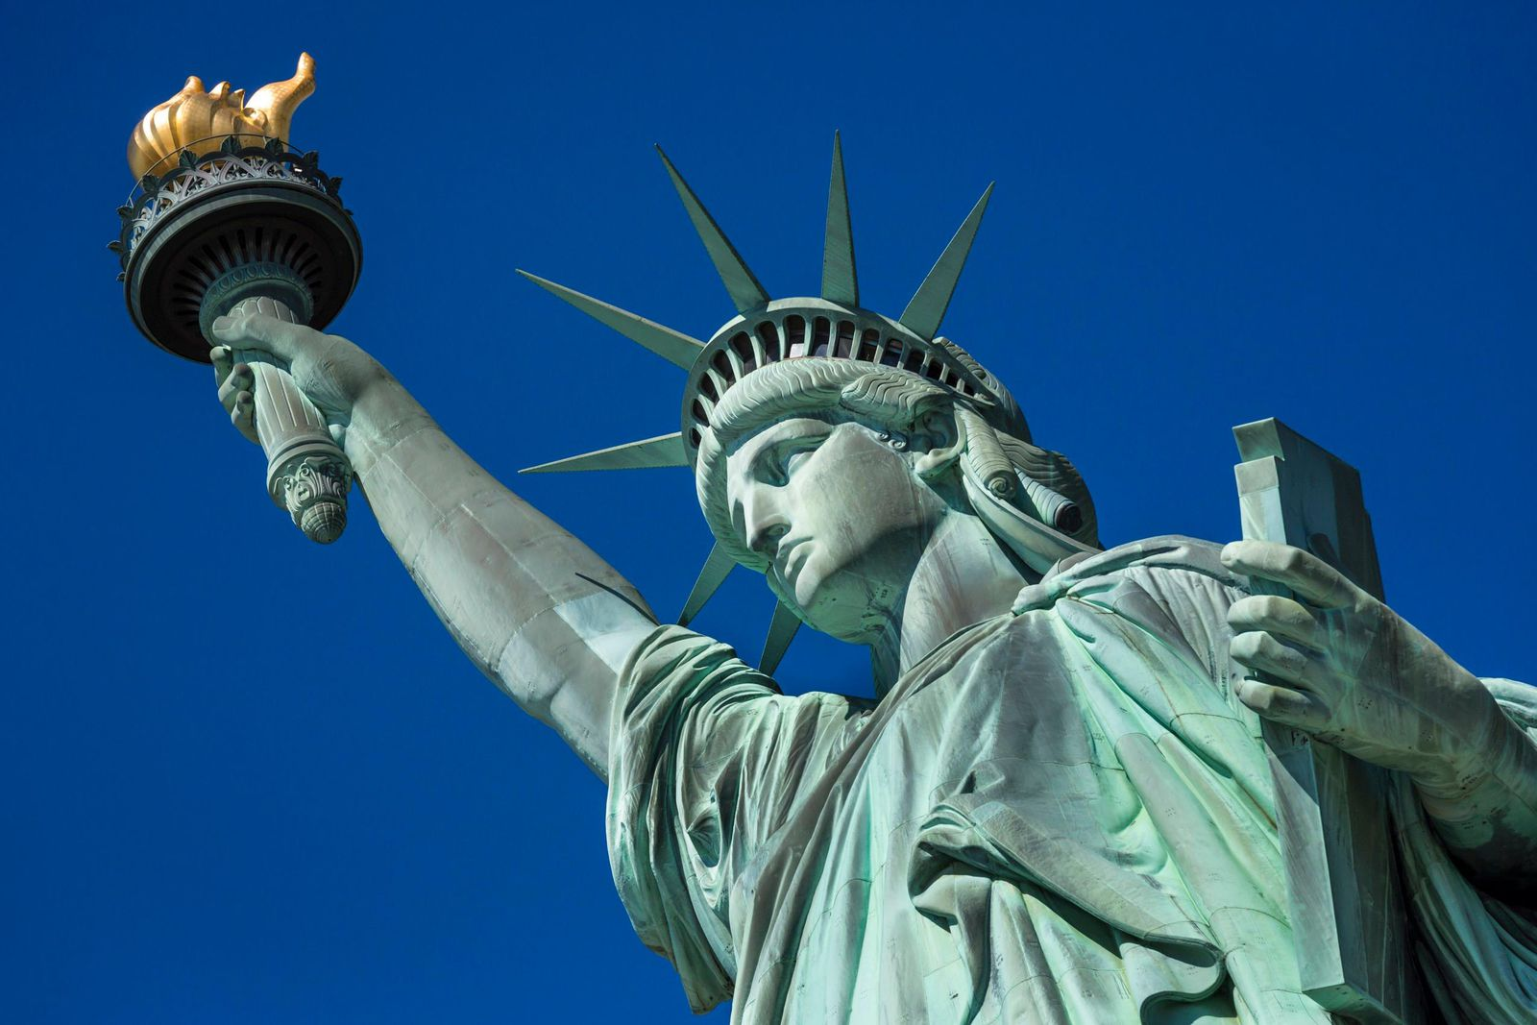
The right to vote is a fundamental liberty right!
“No right is more precious in a free country than that of having a voice in the election of those who make the laws under which, as good citizens, we must live. Other rights, even the most basic, are a losery if the right to vote is undermined!” - Justice Hugo Black

Slide 18
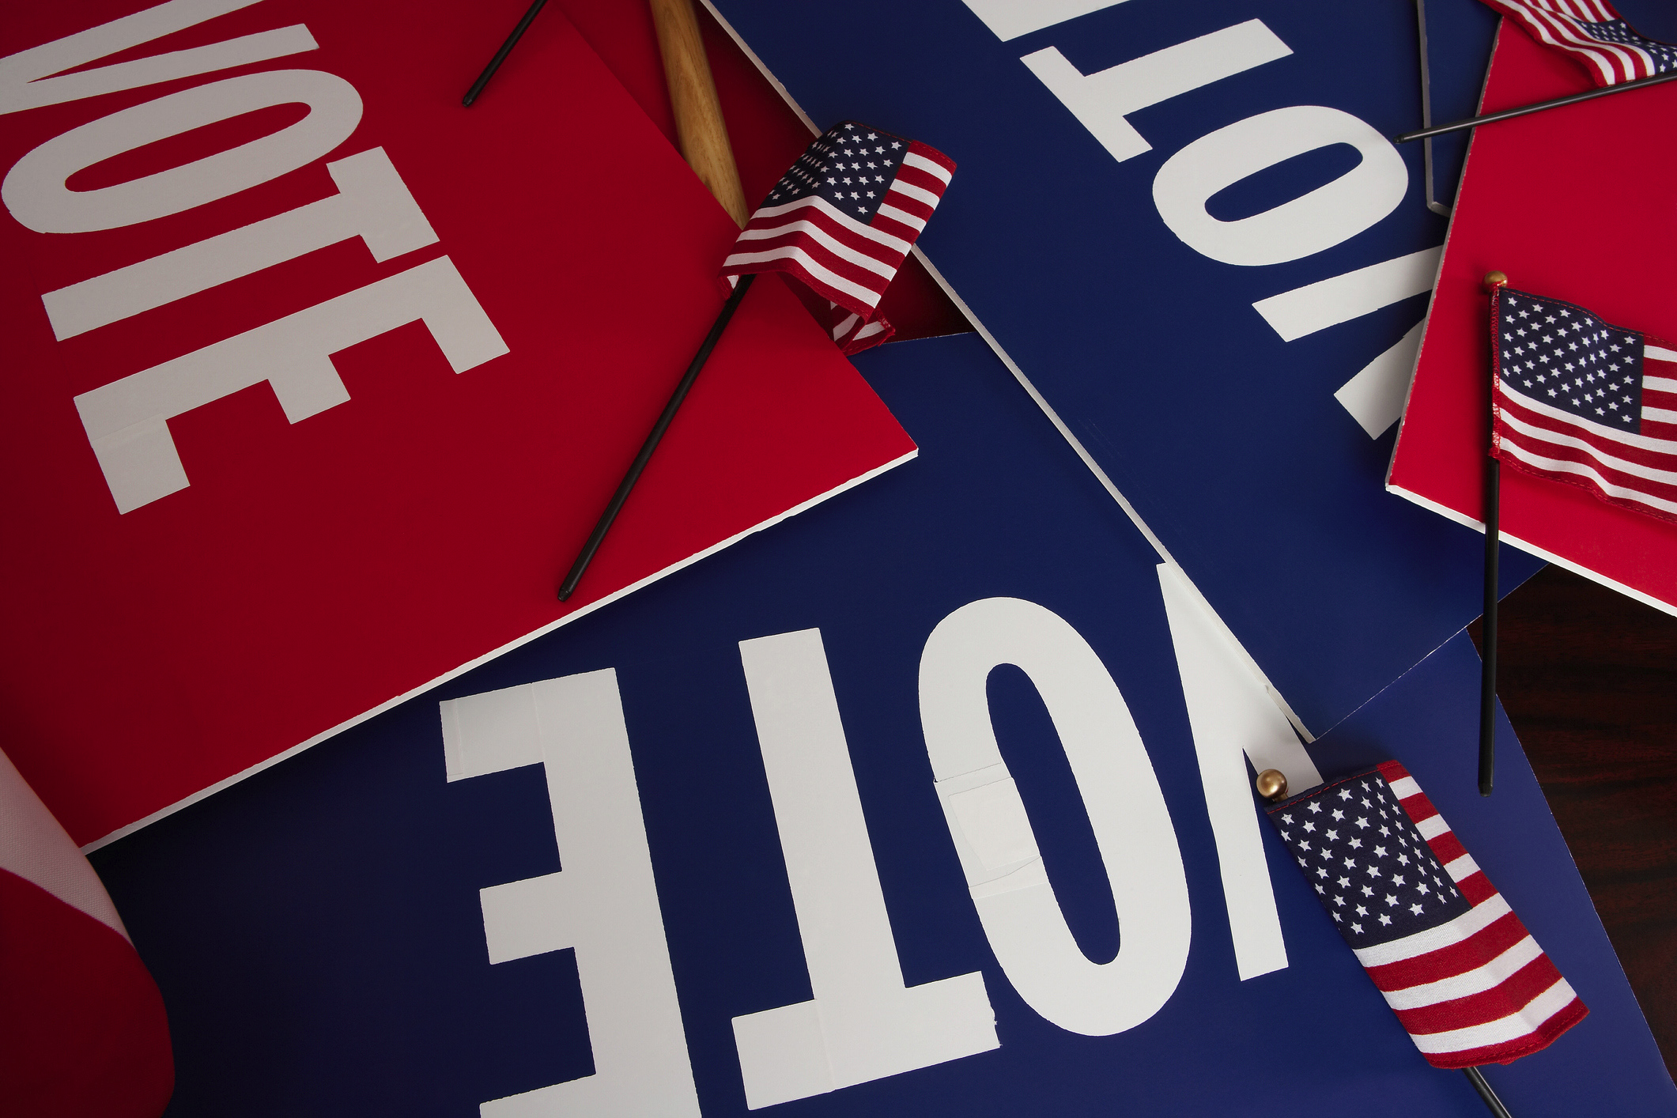
What is Voting??

Slide 19
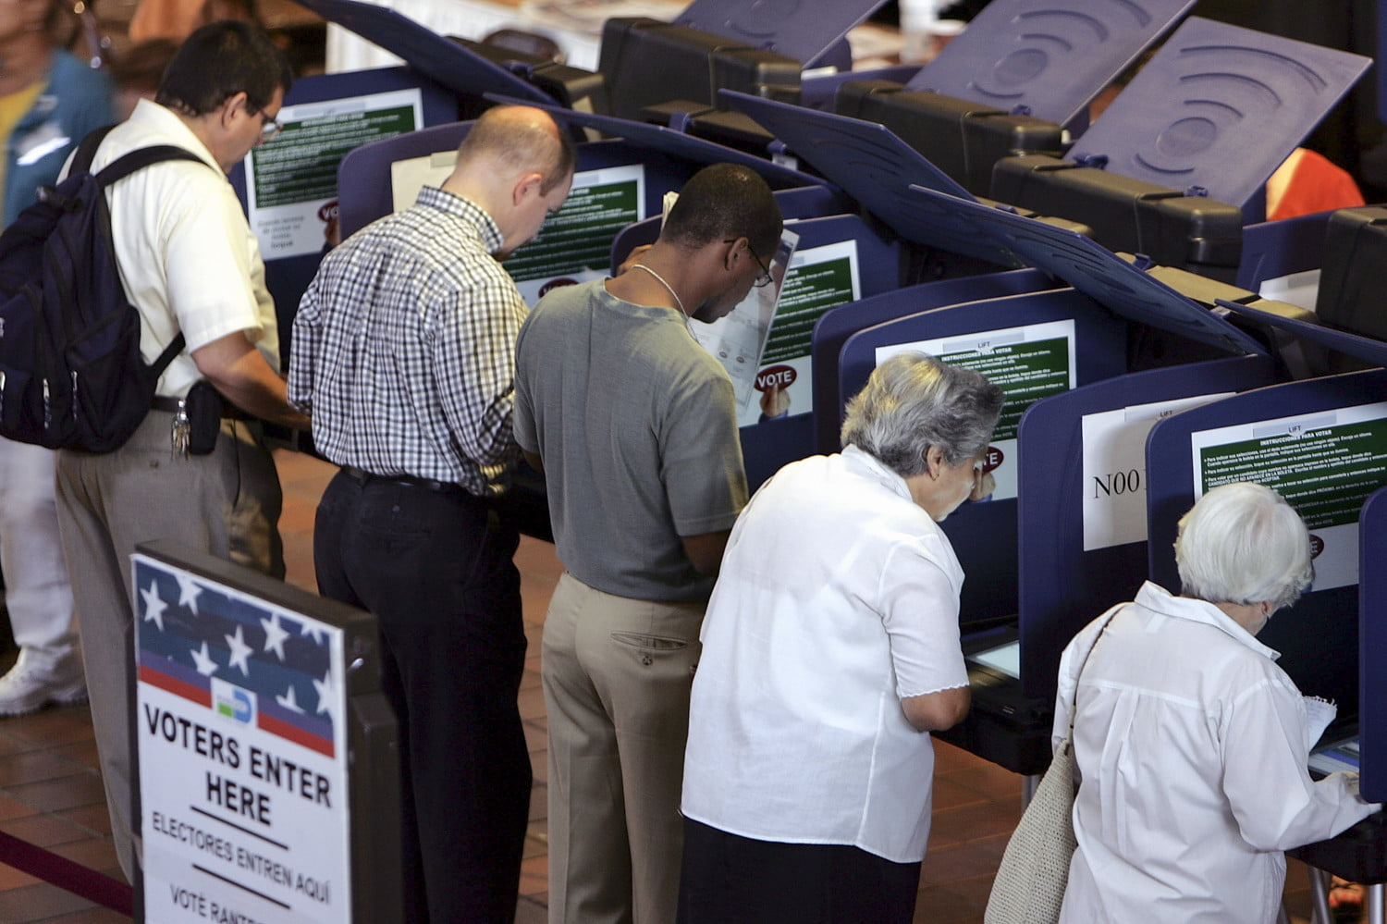
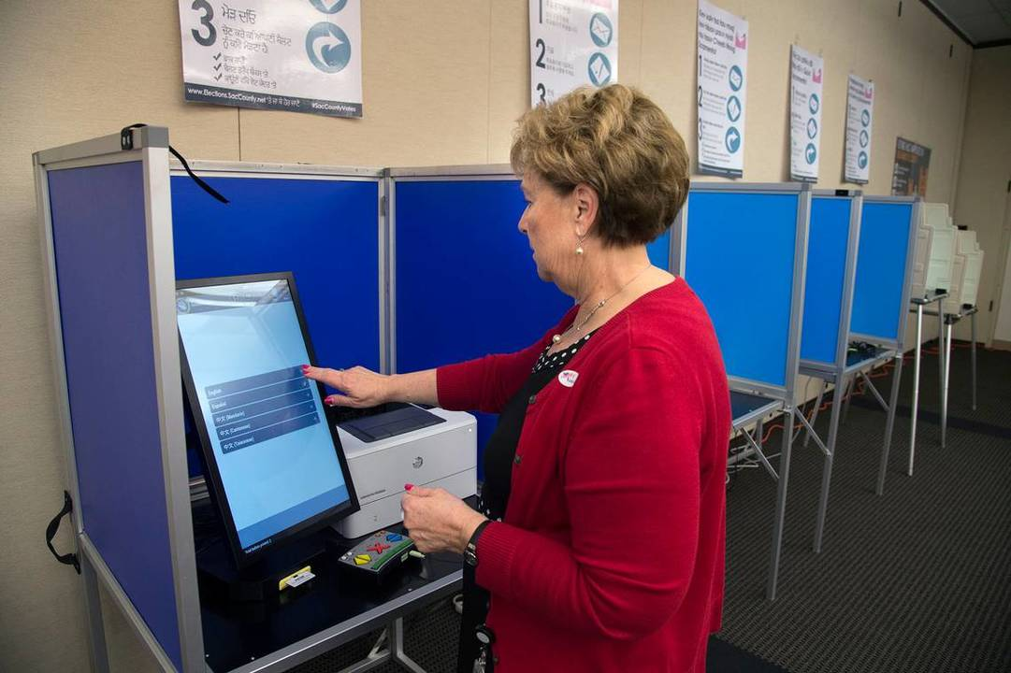
-We vote privately and independently. -Some people mark paper ballots and slide them in a box. -Some people vote using the computer touch screens. -Some people vote with a paper ballot then feed it into a scanner. -Voting is a way to document your choice.
Curb side voting accessible machines absentee ballots
voting on computer and by phone for other things

Slide 20


Slide 21
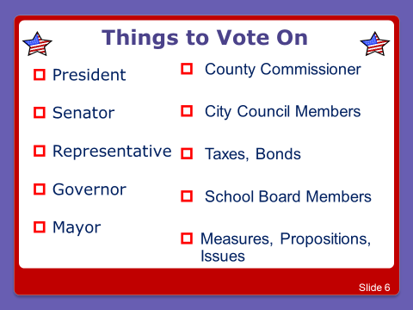

Notes:
types of issues voted on

Slide 22
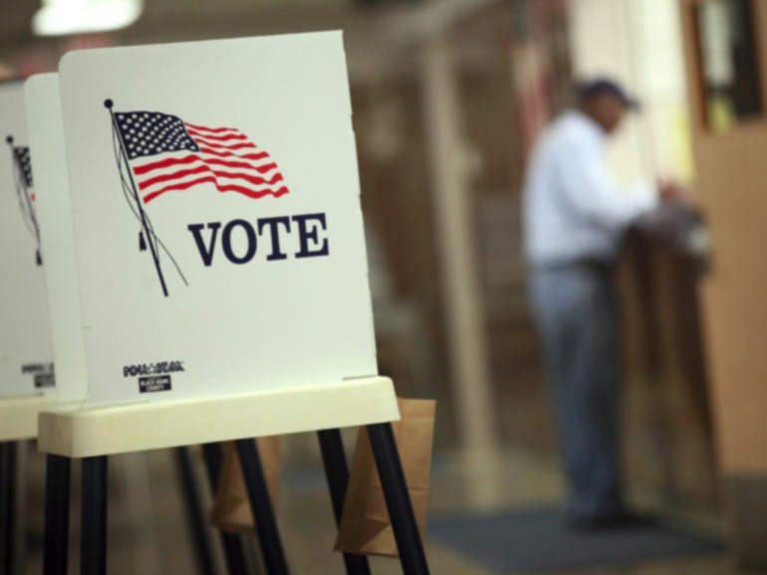
HOW DO YOU VOTE?

Slide 23

You must register to vote at least 30 days before election day!
Go to: http://www.sos.ms.gov/Vote/Pages/default.aspx
Call your local circuit clerk’s office
Call DRMS and we can help – 1-800-772-4057
Register here with us today! We have forms and will mail in for you!
PRIMARY ELECTION DAY for Statewide, State District, Legislative, County and County District Offices. Polling places open from 7:00 a.m. until 7:00 p.m. (Miss. Code Ann. § 23-15-1031)

Slide 24
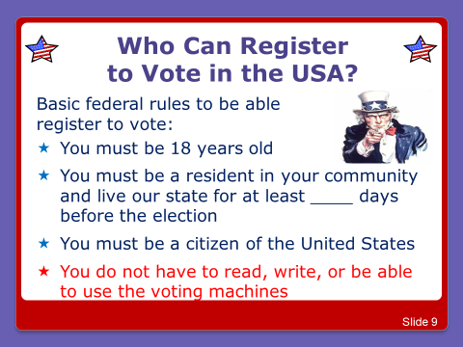

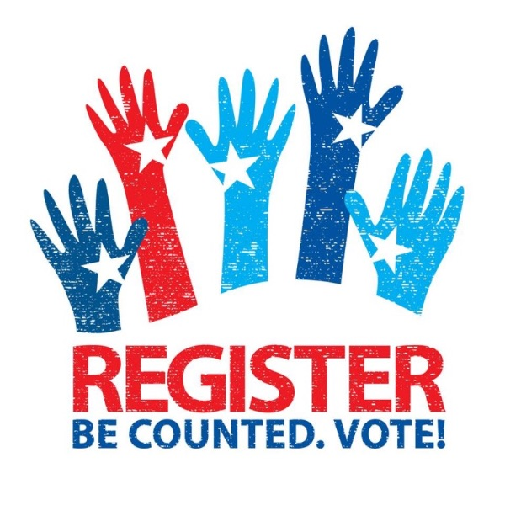
30

Slide 25
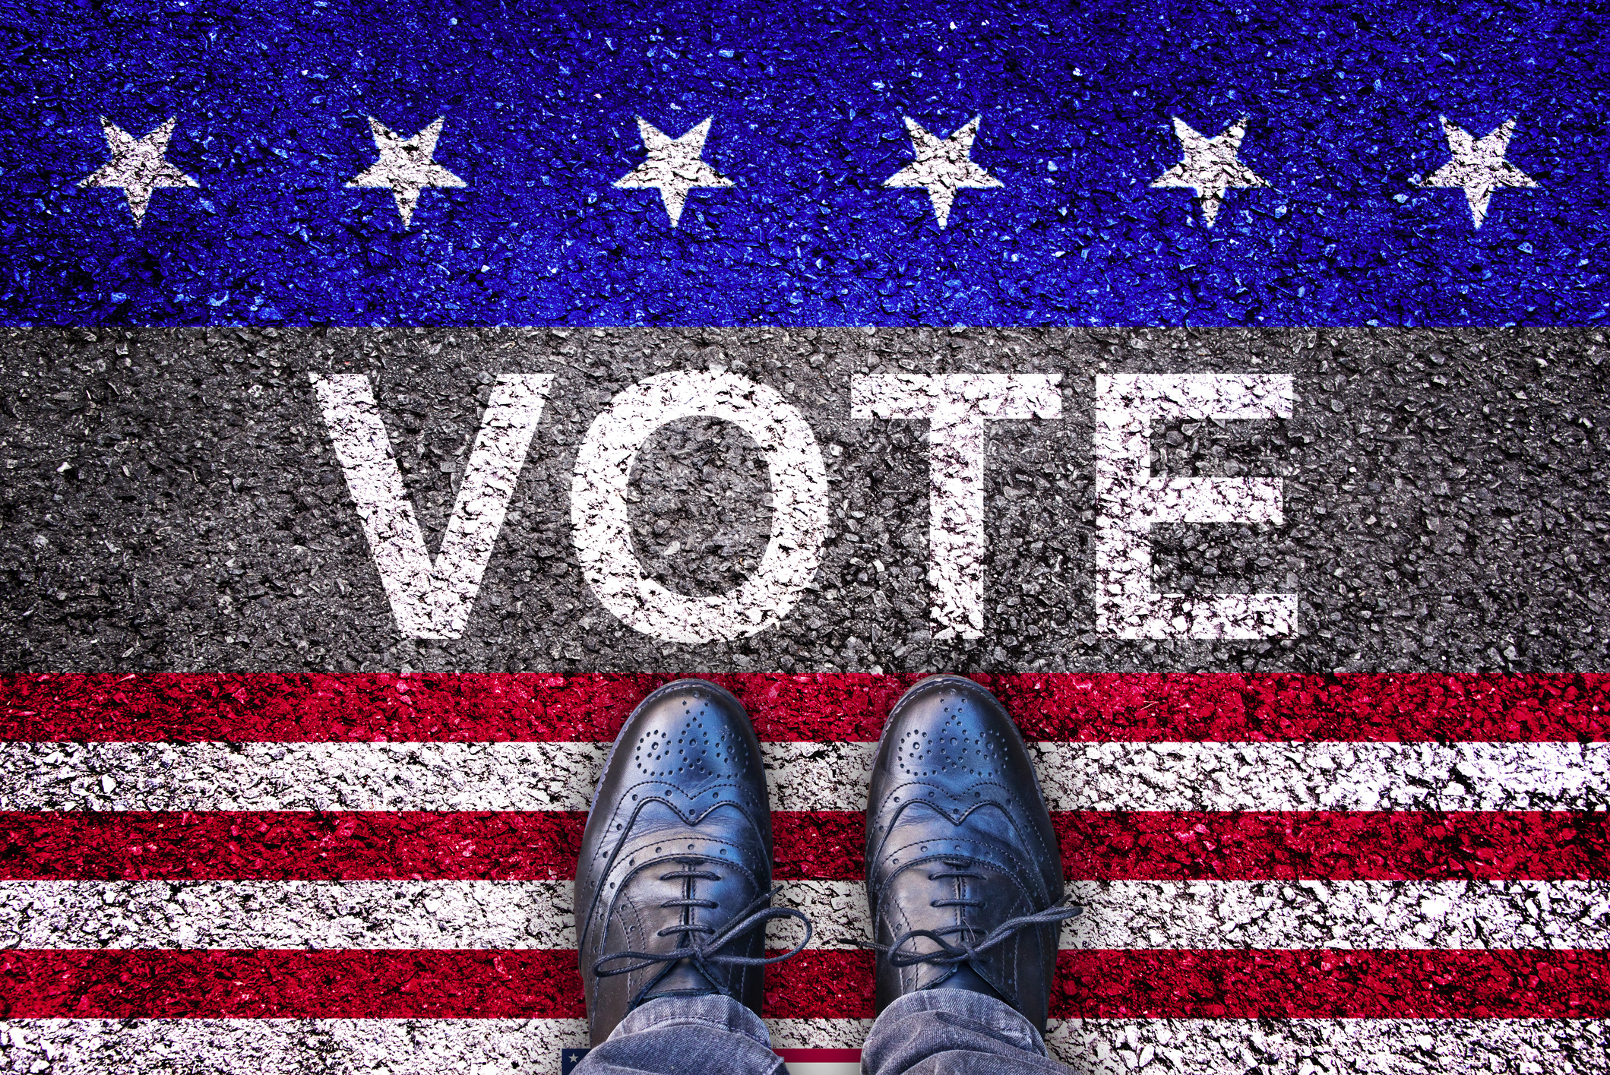

What to Expect?

Slide 26






Make A Plan!
Be aware of any deadlines to register to vote and make sure you’ve registered. Mark your calendar.
Familiarize yourself with the candidates and make a list of who you are going to vote for in each race.
Polling places sometimes change, so it’s a good idea to double check yours online. Find out where to vote at http://www.sos.ms.gov/PollingPlace/Pages/default.aspx
How will you get there? Make plans for transportation. The polls will be open from 7am to 7pm.
Have your ID ready to bring with you. MS requires photo ID, so you’ll need it to vote.
If you will need help voting, already have plans on who you will bring with you to the polling site.

Slide 27
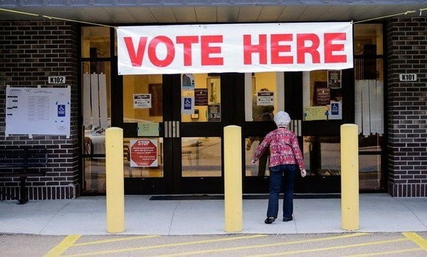
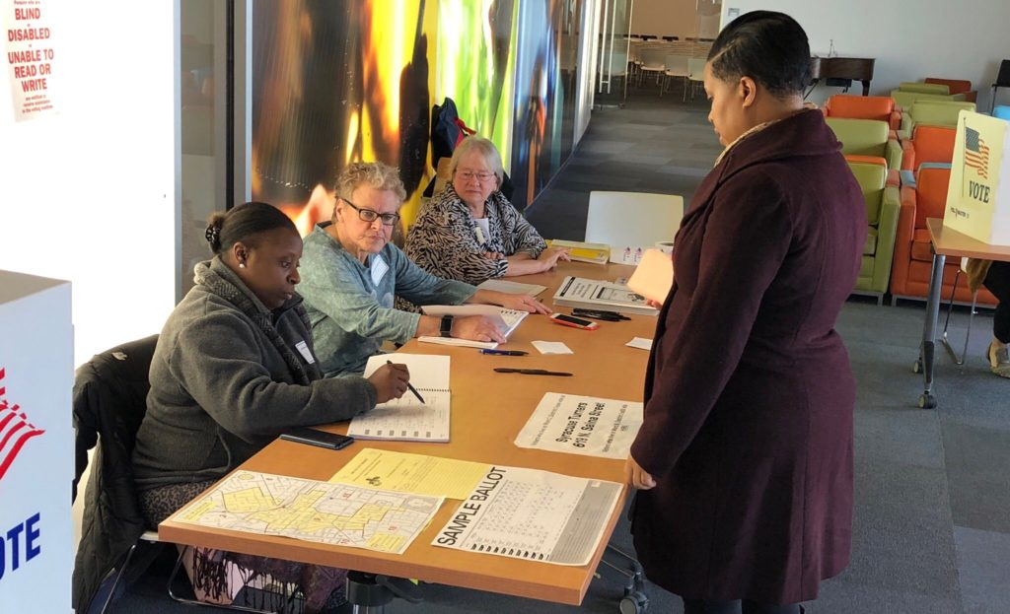
After entering the site by following the signs that should say “Vote Here”, you’ll have to check in and show your ID.
If for some reason they do not find your name on the registration list, then you have the right to ask to vote by affidavit ballot, or provisional ballot. No one should be denied the right to vote, even if they don’t meet some of the qualifications on the day of the election. For more information, call the Secretary of State’s Election Hotline at 1 (800) 829-6786 or visit www.yallvote.sos.ms.gov.

Slide 28
Accepted Forms of Photo ID in MS for Voting
• A driver’s license • A government issued photo ID card • A United States passport • A government employee photo identification card • A firearms license • A student photo ID issued by an accredited Mississippi university, college, or community/junior college • A United States military photo ID • A tribal photo ID • Any other photo ID issued by any branch, department, agency or entity of the United States government or any State government • A Mississippi Voter Identification Card

Slide 29
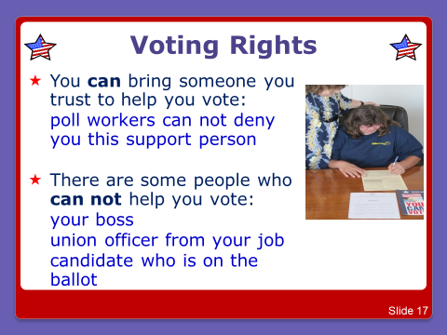


Slide 30
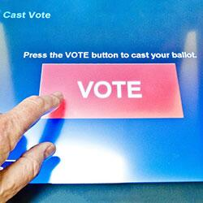
Other Rights as a Voter
Vote if you are a registered voter
Ask questions on election procedures
Vote in privacy and free from coercion or intimidation
Have non-discriminatory equal access to the elections system for all voters, including elderly, disabled, and minority, military, and overseas citizens
Notes:
other rights

Slide 31
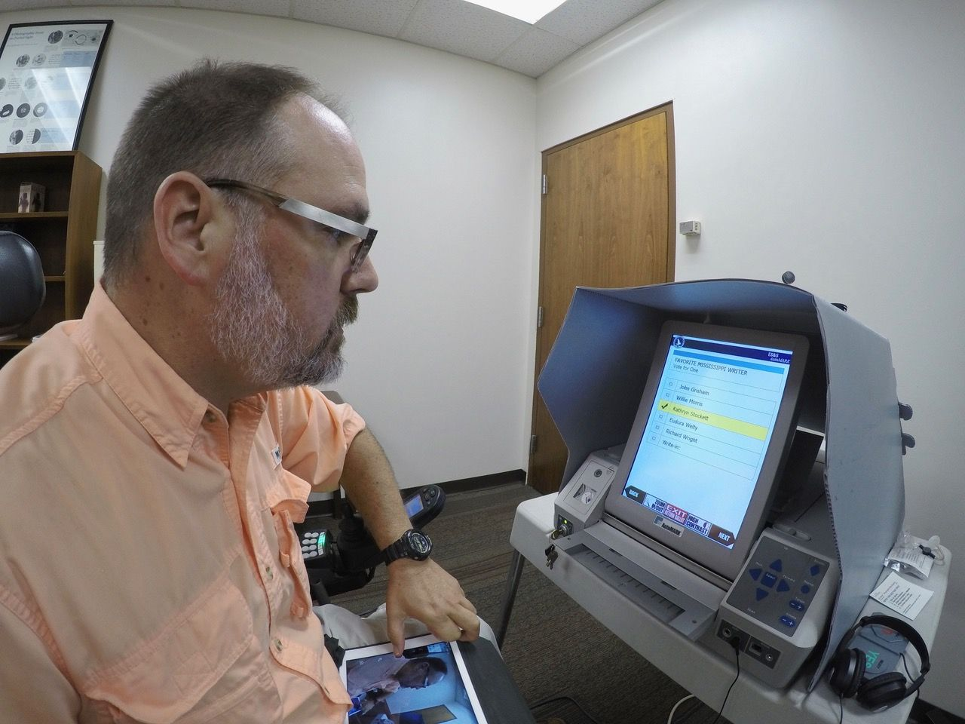
Examples of Accessible Machines in Use in MS
Notes:
Dr. Scott Crawford using the Automark machine

Slide 32
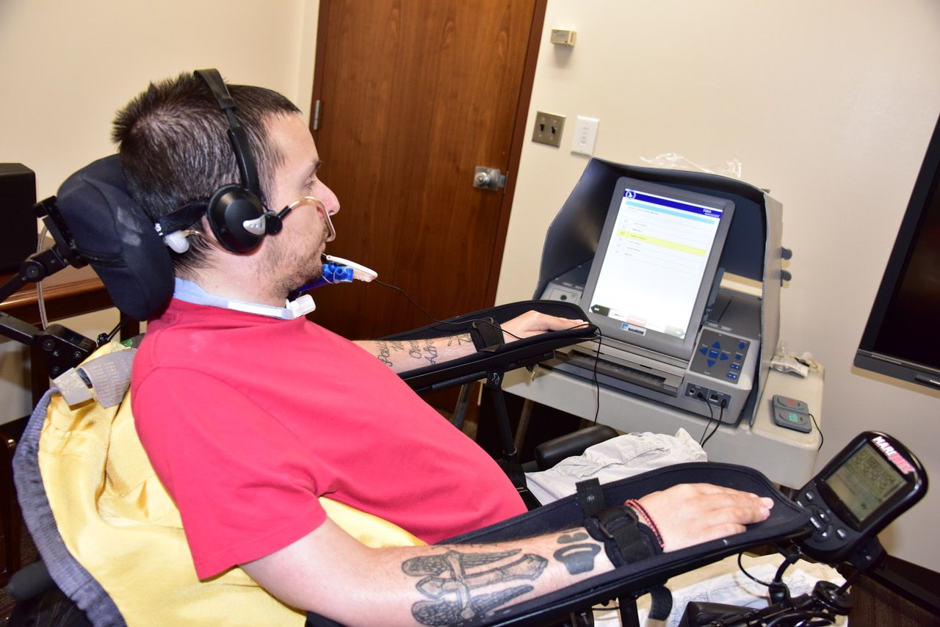
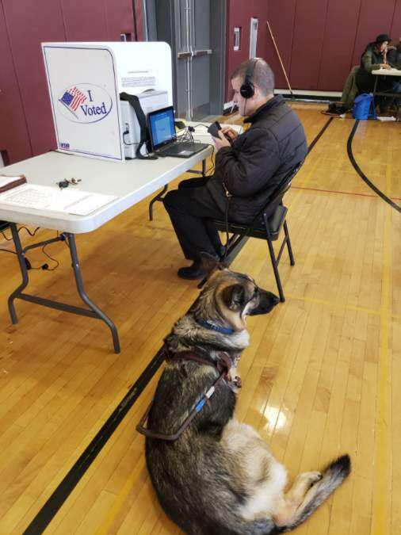
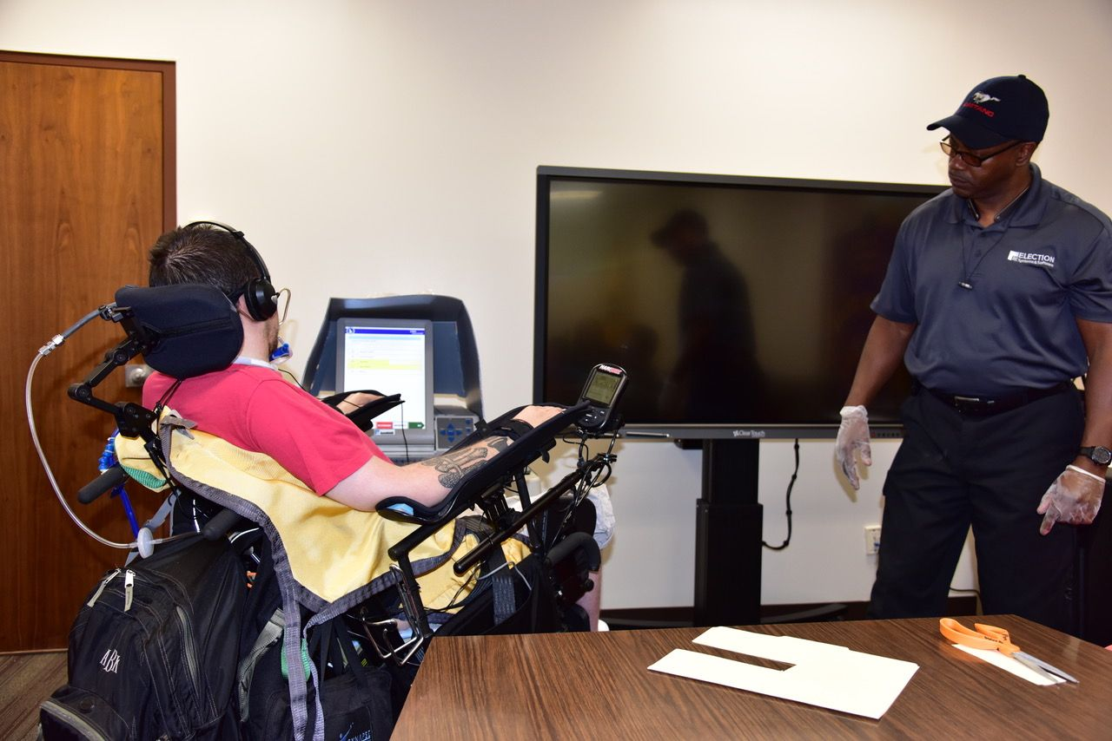
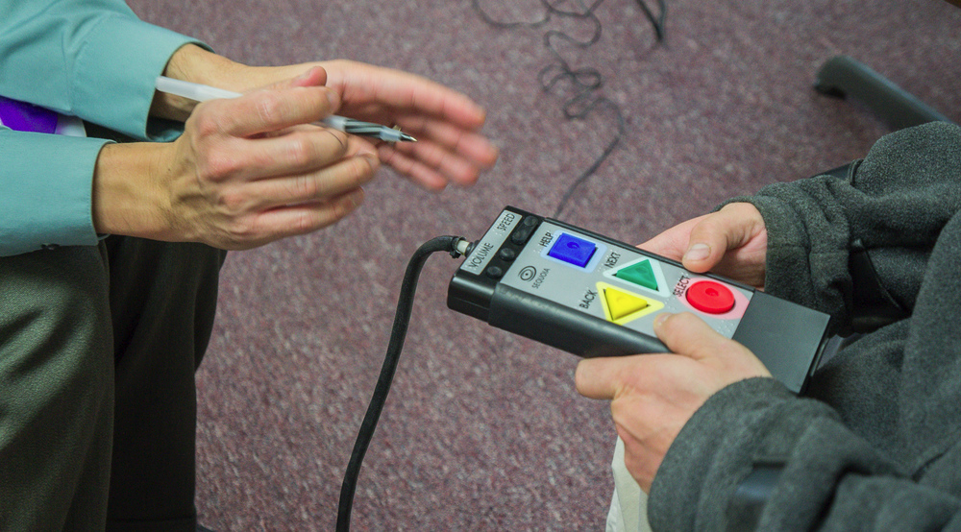
Notes:
Mr. Adam Booker using the AutoMark with the sip and puff mechanism. If on election day you need to use an accessible device, and find that it is not working, or there is some problem that will prevent you from using the machine, then you need to contact DRMS at 1-800-772-4057 immediately.

Slide 33
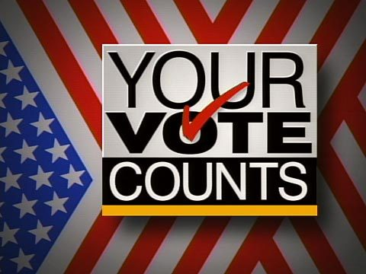
Casting Your Vote
Whatever your method of voting is, it will be recorded by the mechanism being used at that particular precinct. You will more than likely receive a sticker indicating that you voted. Take a selfie and post it on social media,, encourage your friends and family to Get Out and Go Vote! Take pride in being engaged in your civic life! Your votes are counted typically that evening.

Slide 35
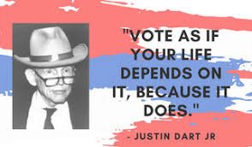


Slide 36


For further voting information and guidance, please visit this site from the DRMS web-site: http://www.votingrightsdrms.org/

